Slide 1
Lake County Safety Council Nutrition and Fitness
Calories In Calories Out
Nancy V Rodway MD MPH
Chris Brill-Packard MA CHES

Slide 2
Objectives
Provide simple steps to improve metabolic fitness and physical fitness
Explain the history behind our current nutritional recommendations and the physiologic consequences
Summarize the current knowledge on nutrition and how it has impacted health and fitness and costs
Add a quickie on cholesterol

Slide 3
EAT ME!!

Slide 4
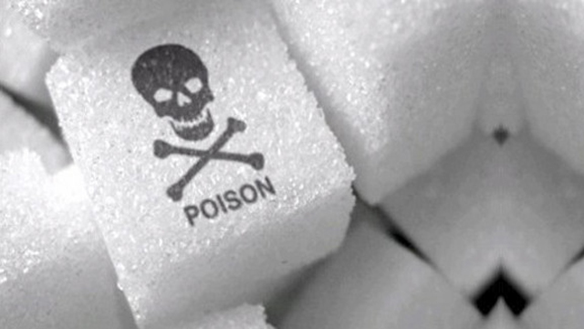

Slide 5
Wheat, especially whole wheat, is more damaging than you think

Slide 6
It’s not nice to fool mother nature!

Slide 8
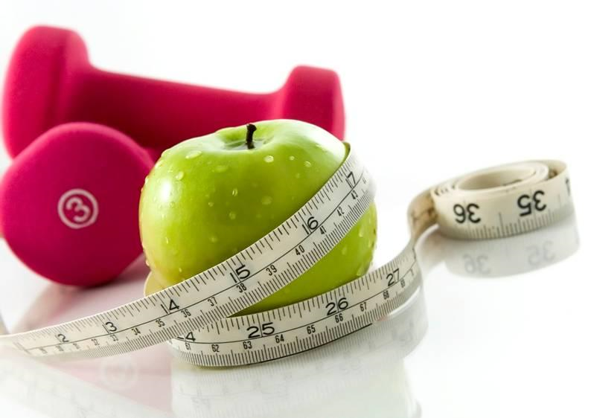

Slide 9
Fat doesn’t make you fat

Slide 10
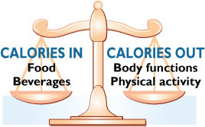

Slide 11
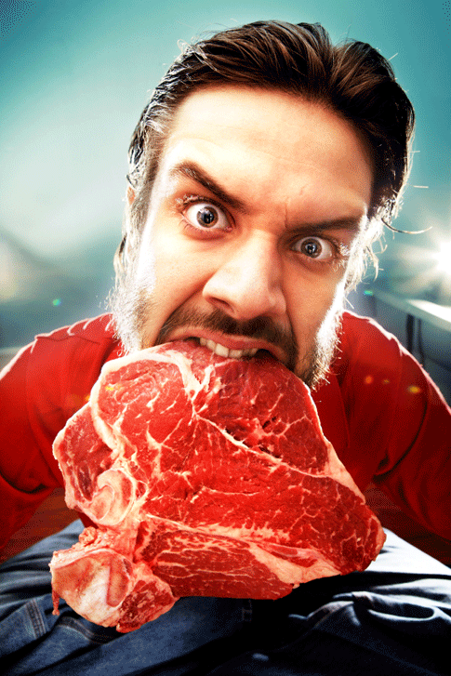
Eating red meat does not increase your risk of a heart attack

Slide 12
Saturated fat is good for you
Full fat dairy is healthy for diabetics

Slide 13
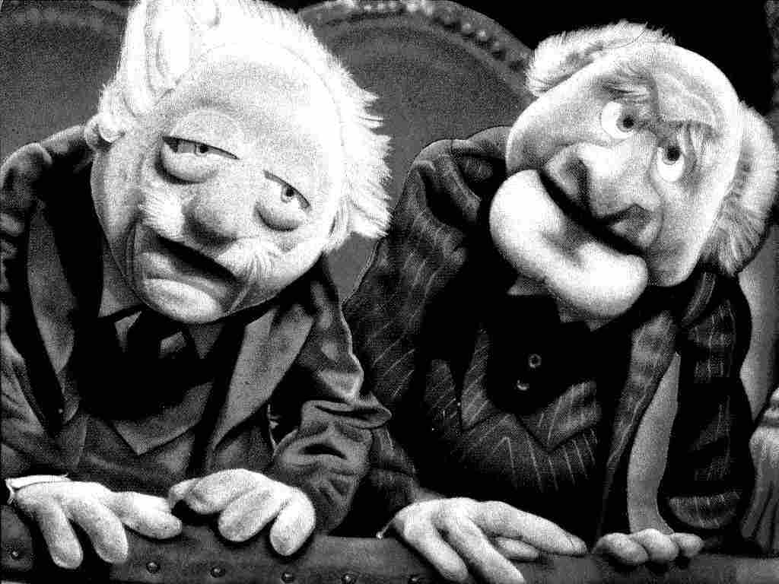
Having a high fat diet does not put you at risk of heart disease

Slide 14
Having a high cholesterol does not put you at risk of heart disease

Slide 15
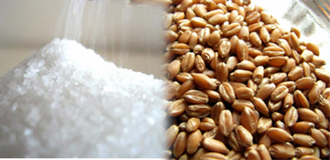
Carbohydrates cause heart attacks
And other bad things . . .

Slide 16
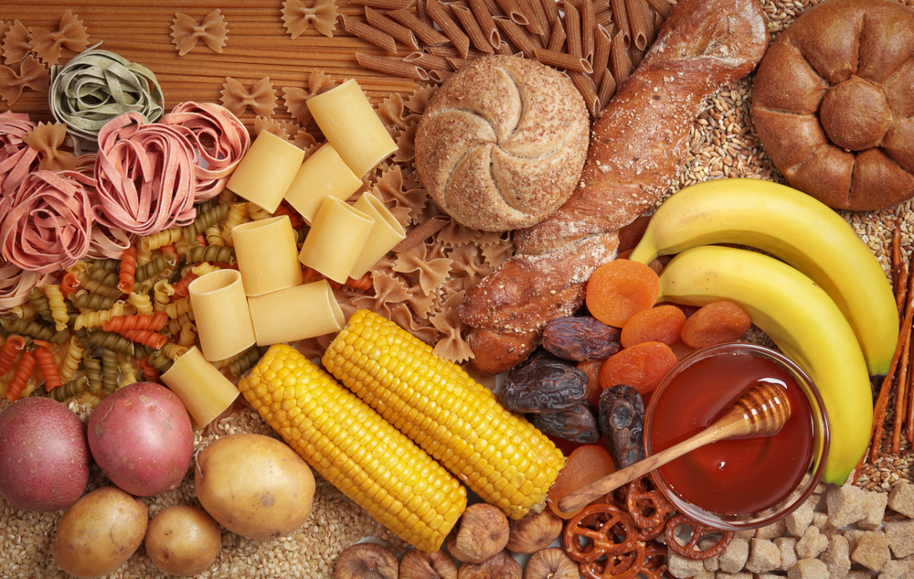
60% of us are sensitive to sugar and carbs

Slide 17
Sugars and Carbs cause:
Arthritis
Rapid aging
Diabetes-related complications
Dementia
Cataracts
Depression
Autoimmune diseases
Irritable Bowel syndrome
Inflammation!

Slide 18
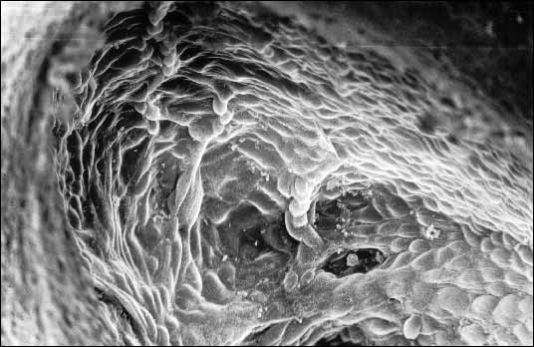
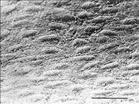
Glycation end products

Slide 19
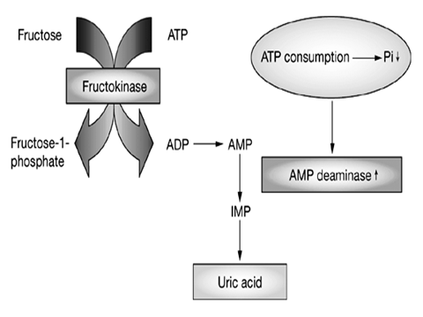

Slide 20
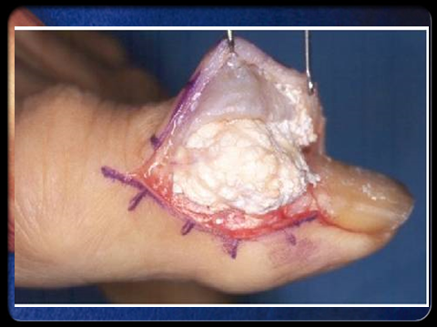
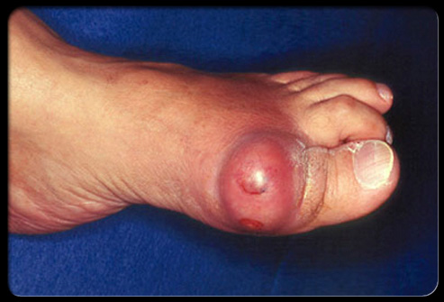

Slide 23
Low fat diets:
High in grains and sugars
Grains cause GI damage and disease
Sugars and carbs trigger high insulin levels
Insulin causes:
Fat deposition and stops fat burning
Energy conservation
Food addiction

Slide 24
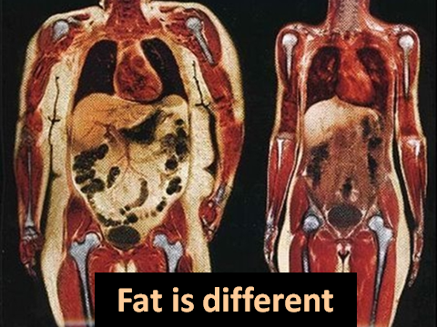

Slide 26
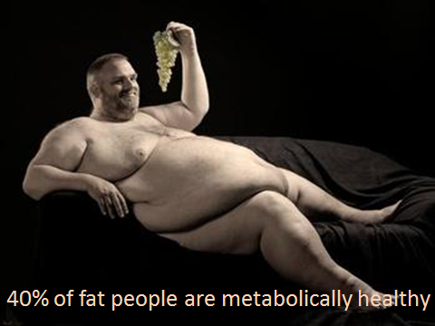

Slide 27
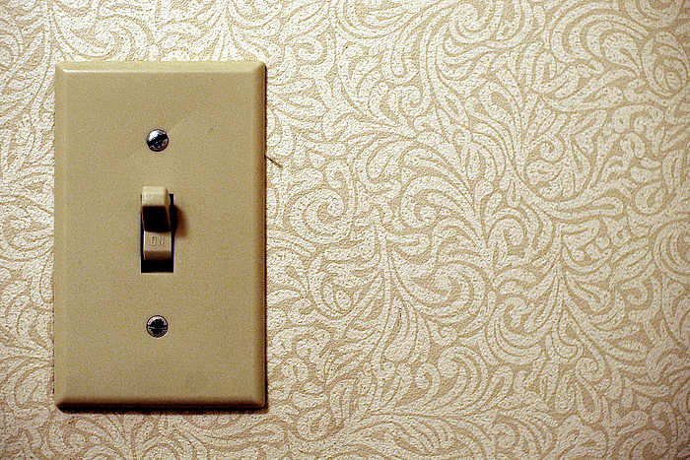

Slide 28
Fat Deposition Switch ON
Fructose (table sugar, fruit juices, pop)
Honey
BEER
High fructose corn syrup
Carbohydrates
Eating throughout the day

Slide 29
Keep the metabolic fire burning!

Slide 30
FLIP THE SWITCH
No transfats
No high fructose corn syrup
Limit sugars
Cut down on wheat (bread and pasta)
Avoid BEER
No “industrial” vegetable oils

Slide 31
You are not fat because you are lazy;
you are lazy because you can’t burn your fat!

Slide 32
The shift to a low fat diet was one of the most dangerous conceptual shifts in public health in American history
Gary Taubes
Good Calories, Bad Calories

Slide 33
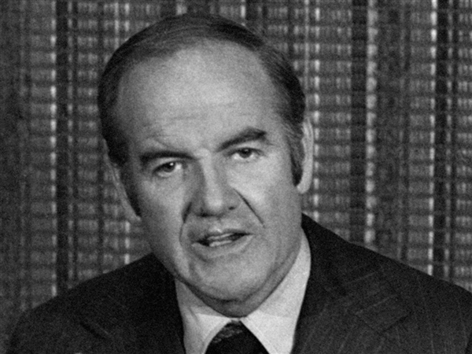

Slide 35
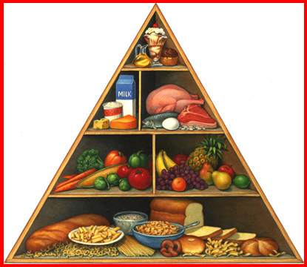
Dietary Goals for the US 1977

Slide 36
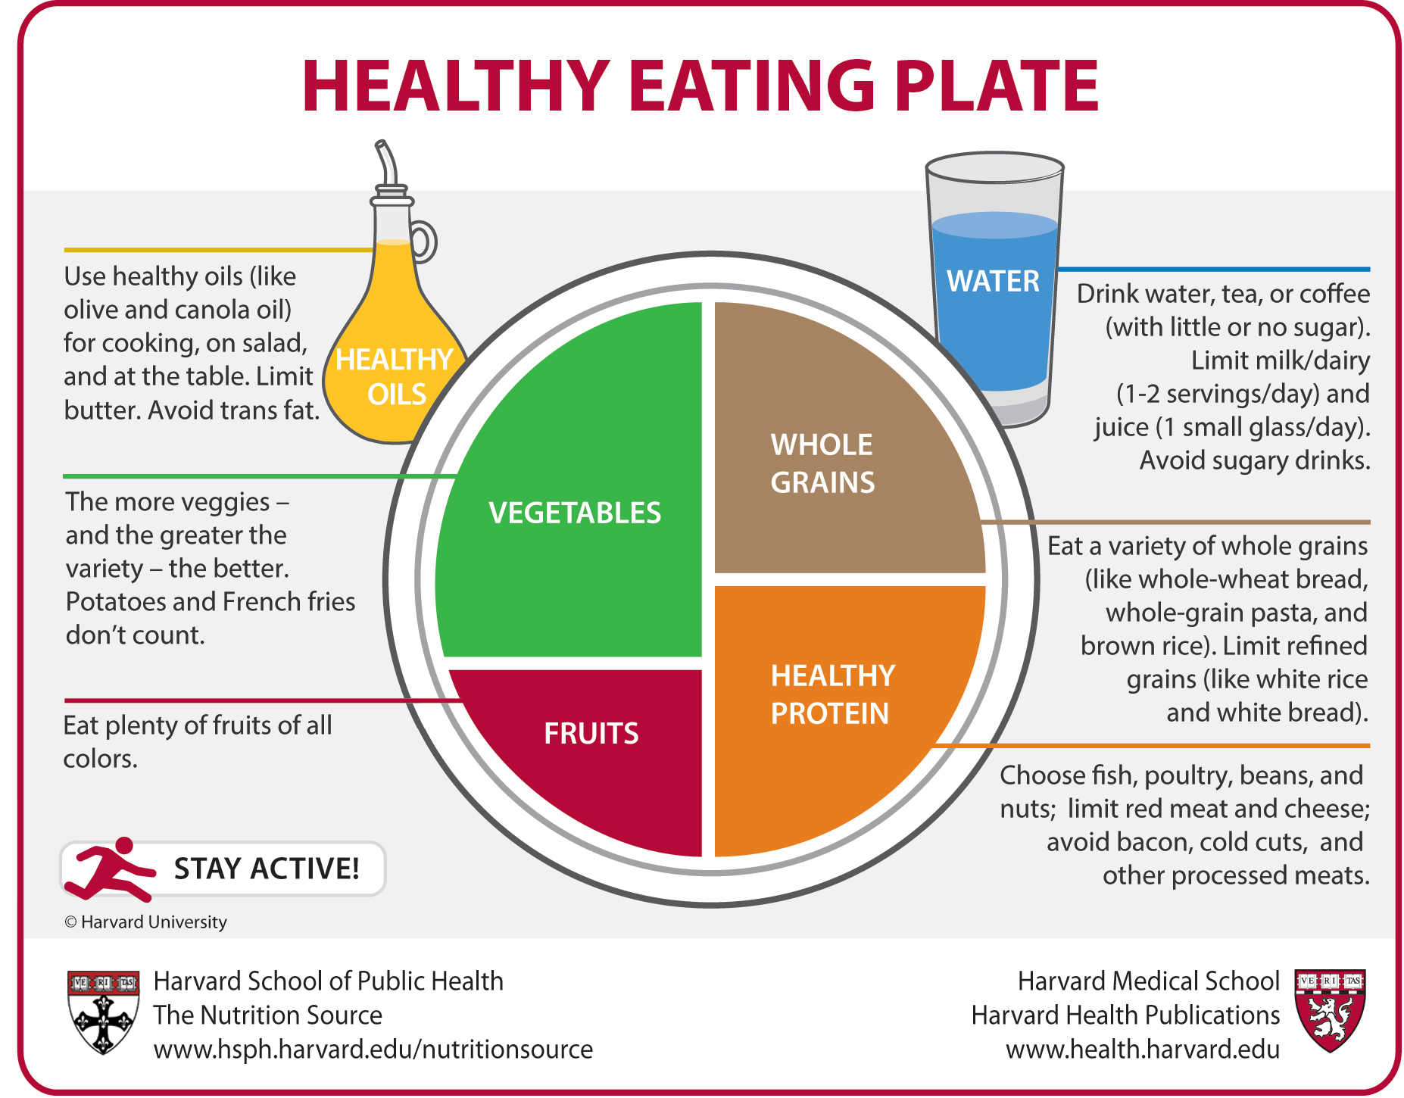

Slide 37
It’s not about your booty
It takes two weeks to become metabolically healthy.
Metabolically healthy leads to happier mitochondria and more energy
Metabolically healthy leads to weight loss
Metabolically healthy=lower claims cost

Slide 38
The average serum cholesterol in acute MI patients is 104 mg/dl
WHICH IS NORMAL!

Slide 39
Those with a cholesterol of 220-240 live the longest
Low cholesterol is linked with stroke, cancer, depression, suicide

Slide 40
LDL “Bad Cholesterol” level is outdated
VERY

Slide 41
It’s the size of the LDL “bad” cholesterol particles that counts
Yes, size does count!
Bigger IS better!

Slide 43
You can have a perfectly normal total cholesterol
and still have a high LDL particle count

Slide 44
You may be on a cholesterol pill and not need it.
You may have a perfectly normal blood lipid panel and be at high risk of a heart attack

Slide 45
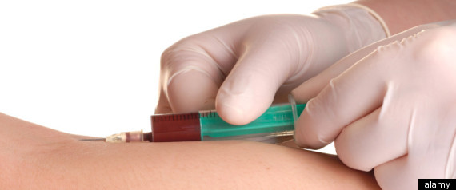
There’s a blood test for that! LDL particle count

Slide 46
Triglyceride/HDL >3

Slide 48
What will make your LDL particles fatter?
Low-carbohydrate diet
Omega 3 fatty acids (fish oil)
Exercise***
Niacin
Statin cholesterol medication . . . sorta

Slide 49
Aerobics don’t cause weight loss
But they give you an aerobic base

Slide 50
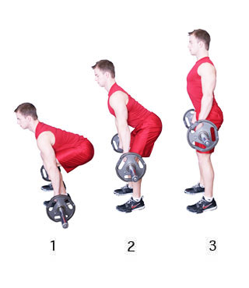
The dead lift

Slide 51
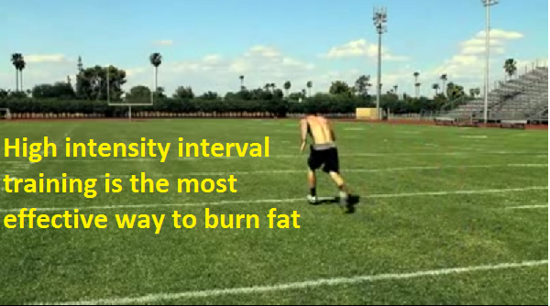

Slide 52
Stretching does not prevent injuries

Slide 53
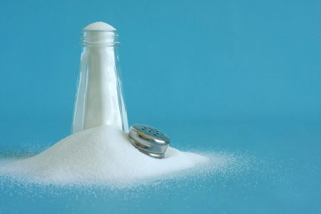
A healthy sodium intake is 4-6 gm daily
Not 1.5-2.0 gm

Slide 54
Clean up your diet
Improves your labs

Slide 55
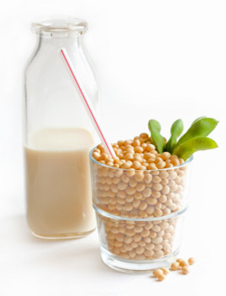
Five foods to never eat

Slide 56
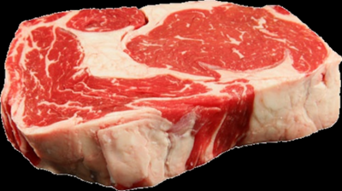
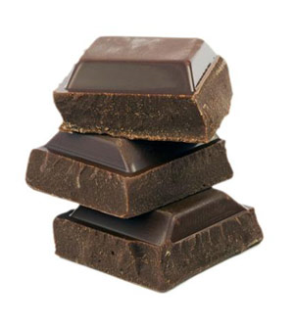
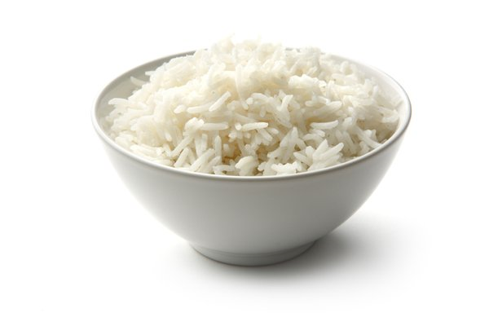
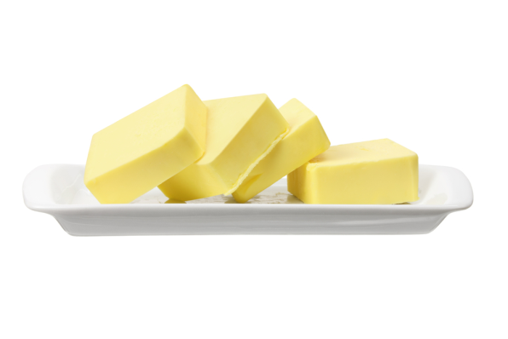
Five foods to eat instead

Slide 57
Summary!
Eat real food including fat
Limit sugar (eat Stevia) because it damages your liver, mitochondria and creates uric acid
Limit wheat because it increases your insulin and causes leaky gut syndrome that causes inflammation and autoimmune conditions
Limit soy because it damages sex and thyroid hormones

Slide 58
EVERYONE IS UNIQUE

Slide 59
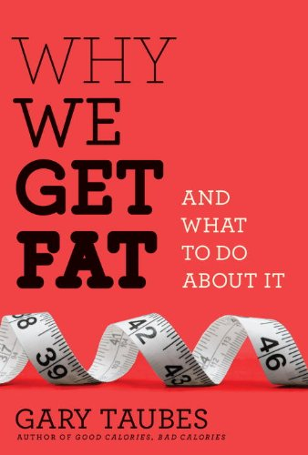
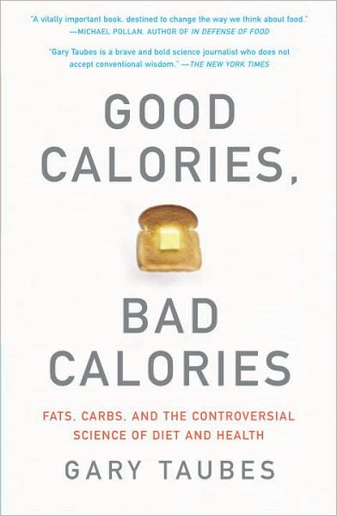

Slide 60
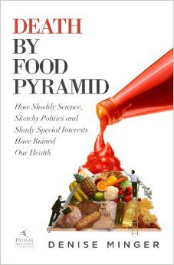

Slide 62
http://www.fhit.org/
Lecturepad.org
Sugarscience.org

